Slide 1
ML Hackathon Approach
Fractal Imagineers B6
~ By Aayush Paikra

Slide 2
Problem Statement:
ABC is an online content sharing platform that enables users to create, upload and share the content in the form of videos. It includes videos from different genres like entertainment, education, sports, technology and so on. The maximum duration of video is 10 minutes.
Users can like, comment and share the videos on the platform.
Based on the user’s interaction with the videos, engagement score is assigned to the video with respect to each user. Engagement score defines how engaging the content of the video is.
Understanding the engagement score of the video improves the user’s interaction with the platform. It defines the type of content that is appealing to the user and engages the larger audience.

Slide 3
Step 1: EDA
Performed various Univariate and Bi-variate Analysis and got some conclusions that improved accuracy:
Views and followers are correlated so we can remove views as it has more unique values.
Category ID and Video ID are highly correlated so we can remove video id as it has more unique values.
Removing Views and Video ID will make all features independent of each other.

Slide 4
Step 2: Pre-processing
Convert categorical data to Binary using pd.get_dummies.
Remove following features:
Row_id : As mentioned in problem
Views : Views and followers are correlated so we can remove one of them.
Video_ID : Video_ID and Category_ID are correlated so we can remove one of them.

Slide 5
Step 3: Various Model fitting
Following models are fitted to the given data:
KNN
Linear regression
Decision Tree
Random Forest
XG Boost
And r2 score is calculated to each model

Slide 6
Step 4: Optimization of Models (By Adjusting hyperparameter)
This is achieved by k-fold cross validation where hyper parameters are adjusted and r2 score is evaluated.
A plot between hyperparameter and r2 Score is plotted.
The hyper parameter with highest r2 score is then selected for optimum performance of that model.

Slide 7
Step 5: Improving Accuracy by ensembling
This is achieved by ensembling all models.
Final output is weighted average of outputs of all models.
Weights are selected based on the r2 score of individual models.
From hit and trial weights are decided as follows:
XG Boost—----------------50%
Random Forest—--------27.6%
Decision Tree—----------6.4%
Linear Regression—----8%
KNN—----------------------8%
=> from this my score is 0.42554

Slide 8
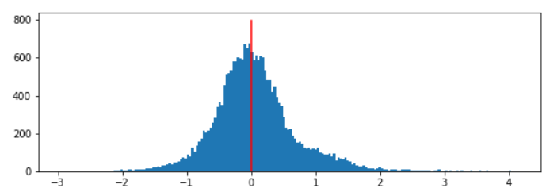
Step 5: Improving Accuracy by ensembling
Distribution of Errors in ensemble model corresponds to r2 score of 0.4255

Slide 9
Thankyou

